Slide 1


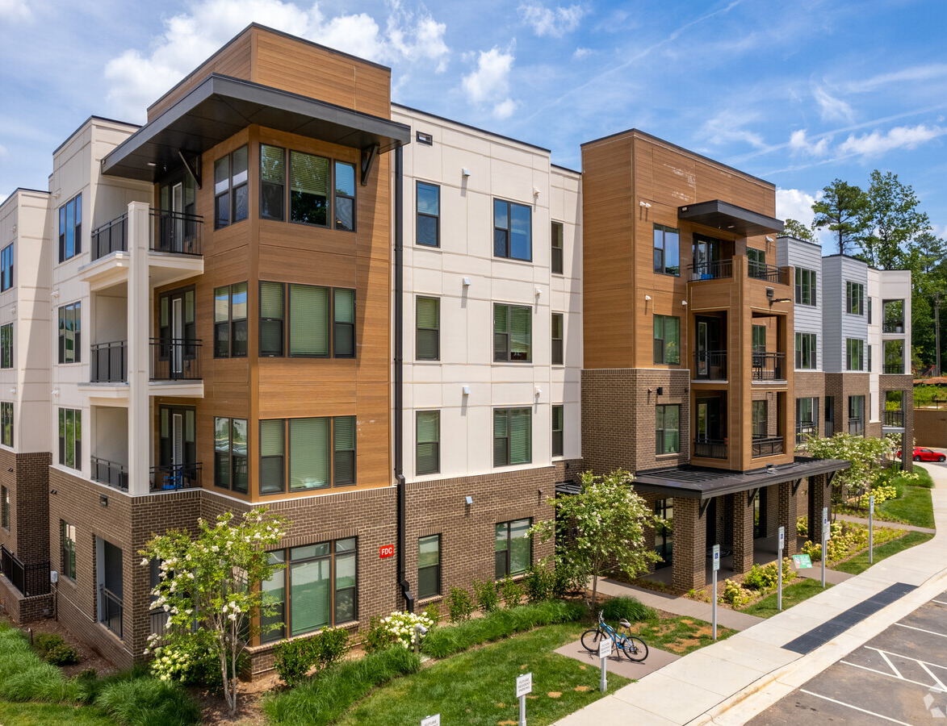
Vintage Jones Franklin
Tamara Villarroel, George Booth, Izzy Andresen, Brian Fantaci
Notes:
George

Slide 2
Data flow diagram package
Level 0
Level 1

Slide 3
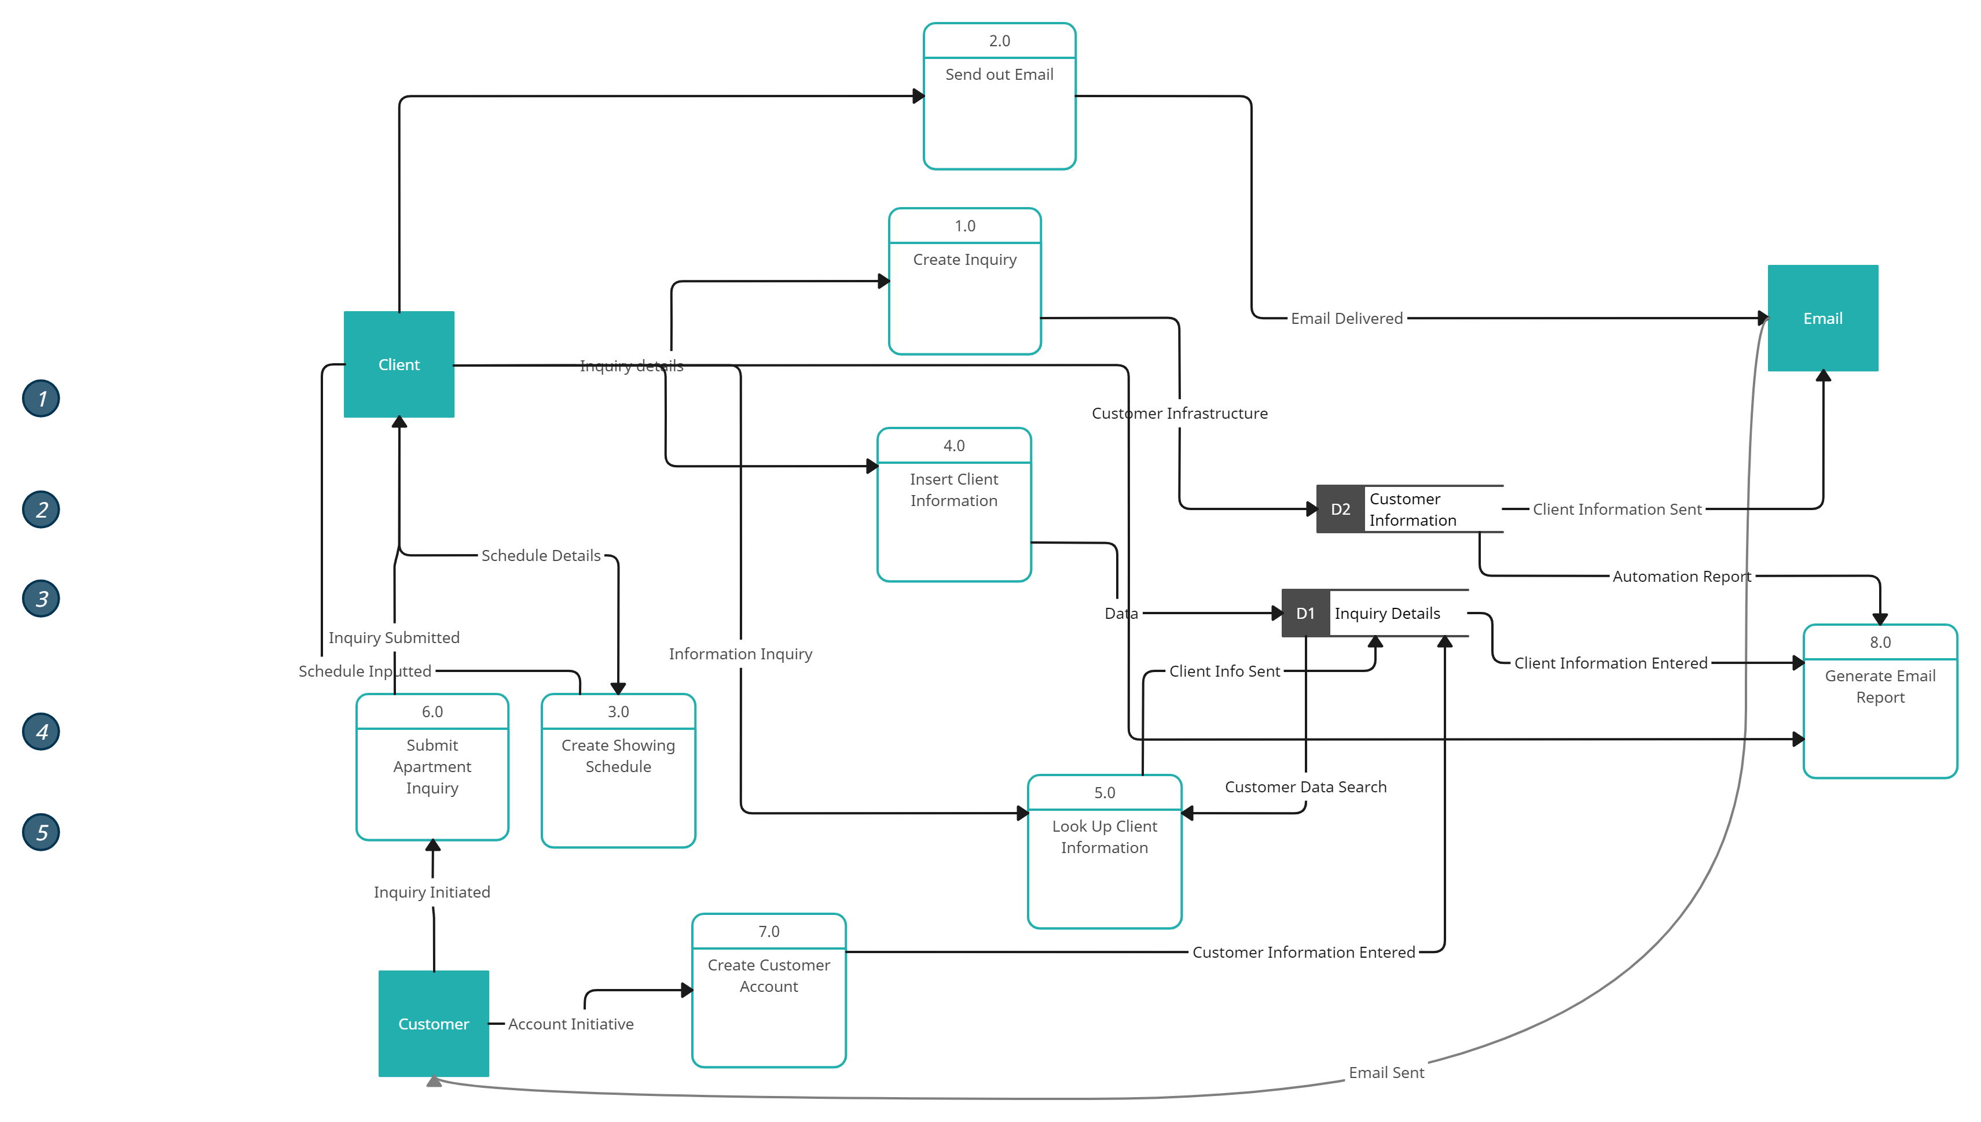
Level 0 - DFD

Slide 4
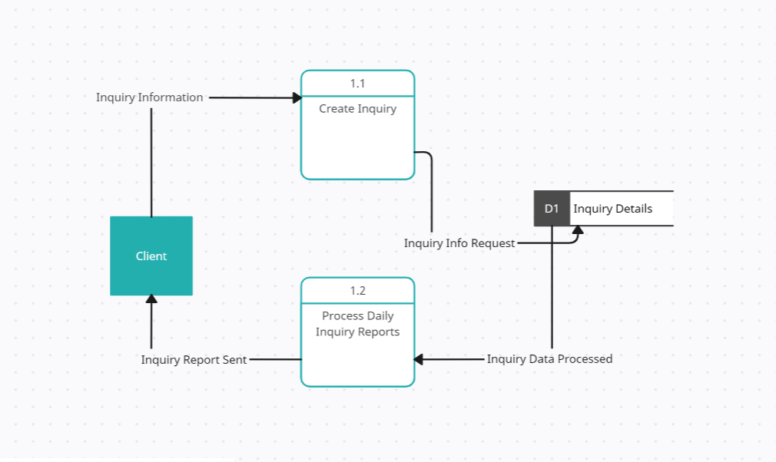
Level 1 - DFD

Slide 5
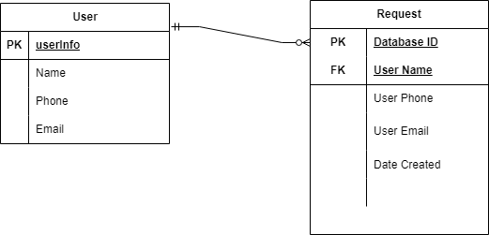
Entity Relationship Diagram

Slide 6
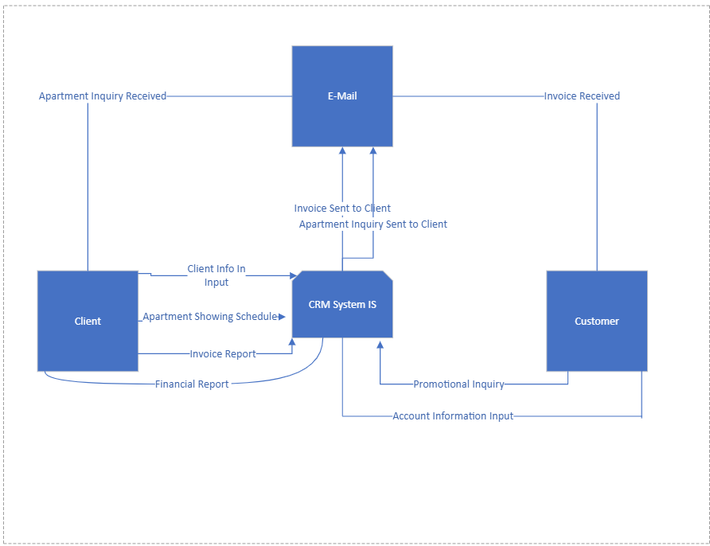
Updated Context diagram
Notes:
Tamara

Slide 7
Updated Use Case Diagram
Create Client Profile
Generate Inquiry Email to Client
Create Showing Schedule
Input Client Information
Submit Apartment Inquiry
Create Client Profile
<<Email>>
Leasing Consultant
Client
Notes:
Tamara

Slide 8
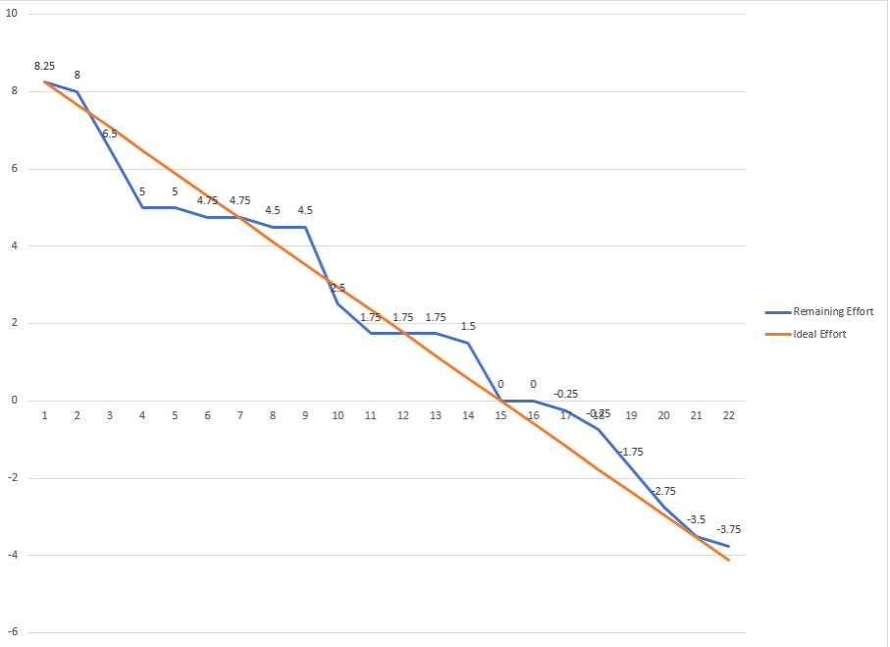
Burndown Chart Data
Notes:
George

Slide 9
Program plan – ipo Chart
Input | Processing | Output
User will generate guest card Employee generates automated follow ups | Website will add guest to the database Website will define time increments to send pre-determined follow up emails | Guest will now be viewable by employees Guest will receive automated follow-ups to increase total occupancy percentages

Slide 10
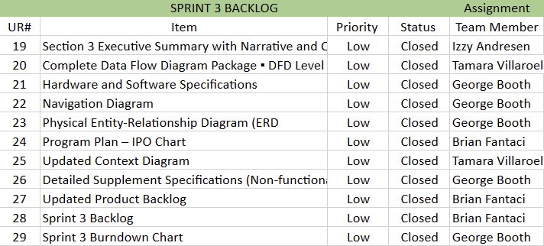
Sprint 3 backlog
Notes:
Brian

Slide 11
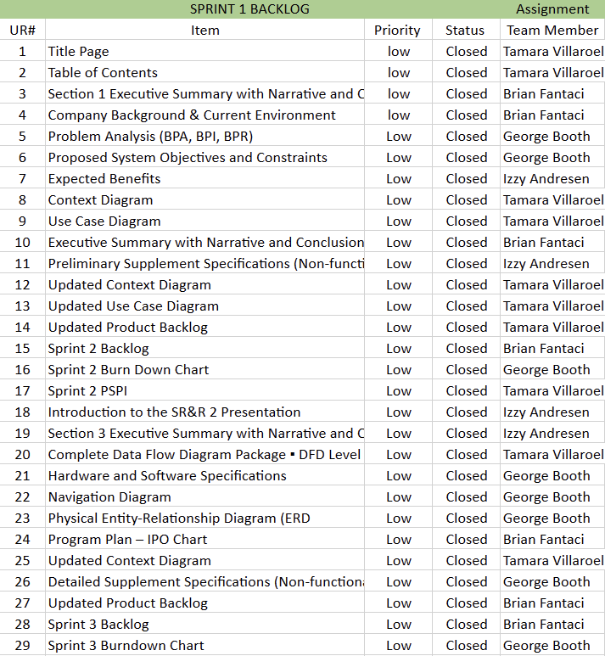
Project Product backlog
Notes:
Brian

Slide 12
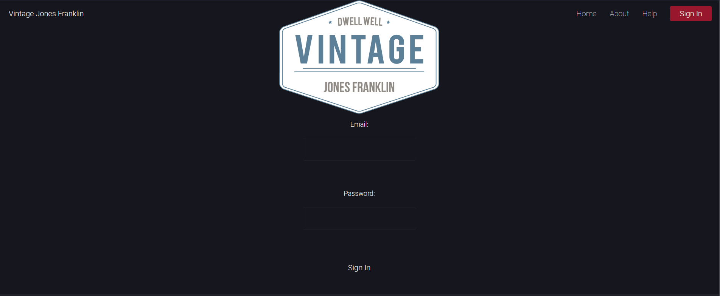
potentially Shippable Product Increment
Notes:
Brian

